Slide 1
NLP
MACHINE LEARNING
CTD DATABASE
Analyzing Health Risks in Grocery Food Products Using Ingredient and Chemical Data
Snack Health Risk Analyzer
Detecting harmful chemicals in 100K snack products
using NLP · Machine Learning · CTD Scientific Database
Sai Lavanya Puthila , Zach Edward · Masters Capstone · Team C
99,958 Products · 207 Chemicals · 99% Accuracy · 10+ Languages · CTD 179K

Slide 2
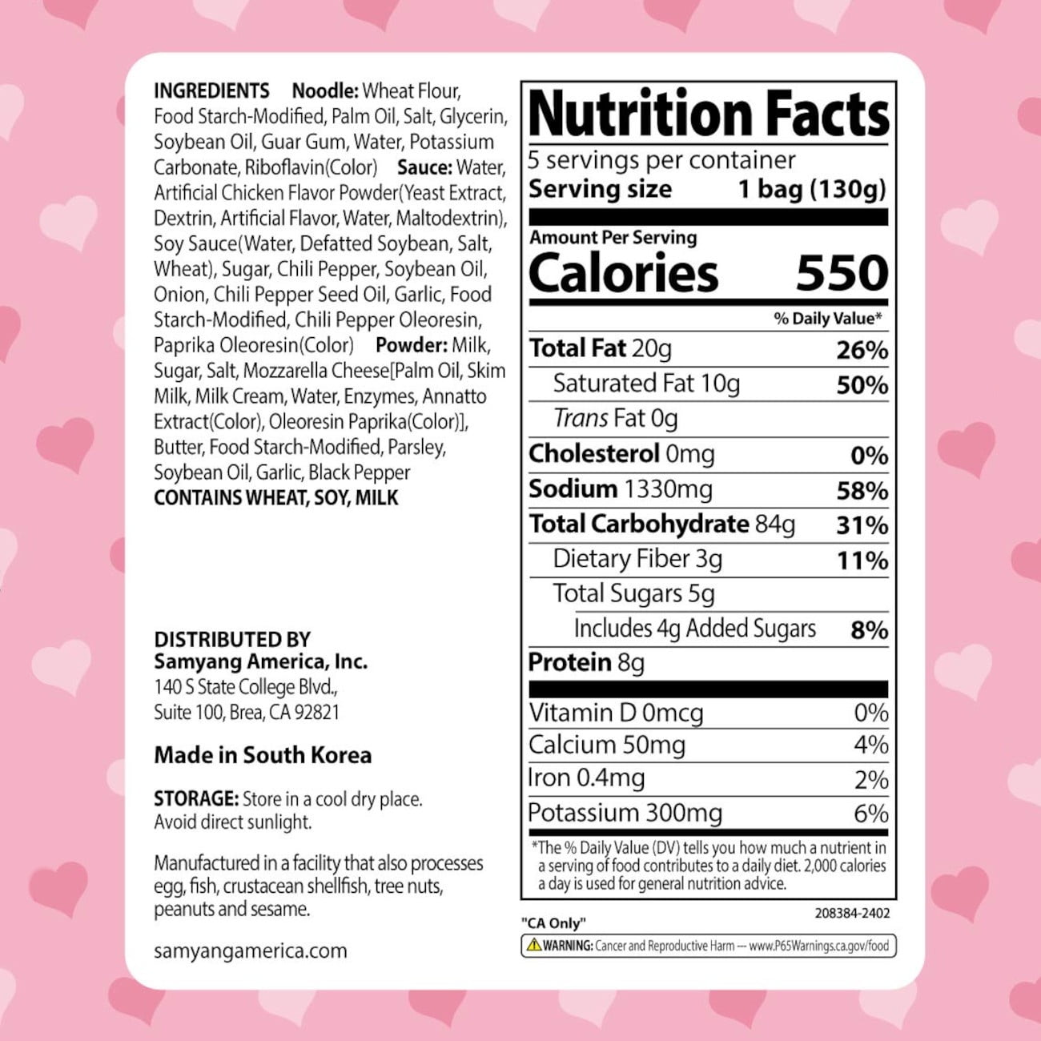
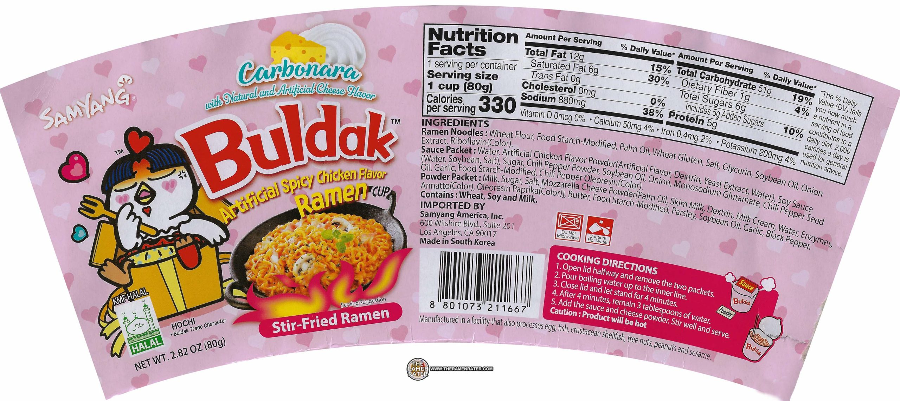

Buldak
In USA
In South Korea
ap
Connect large-scale grocery product data with CTD chemical–health datasets — something no existing tool does automatically

Slide 3
Why This Project?
Packaged foods contain long complex ingredient lists with additives that are difficult to interpret at scale. Scientific databases exist that link chemicals to health conditions — but this information is never connected to real food products.
🛒
🏷️
🧪
❓
70%+
200+
30+
Zero
packaged snacks
contain at least one
harmful additive
ingredients on average
snack label — impossible
for consumers to check
chemicals linked to
cancer, ADHD &
heart disease
tools existed to
auto-detect ALL
harmful chemicals
💡 We built a system that reads ingredient text, detects harmful chemicals using NLP, and classifies every product by health risk

Slide 4
Data Cleaning Pipeline
Before Cleaning
After Cleaning
12GB+ file • Millions of rows • All categories • Missing ingredients • Duplicates • 10+ languages mixed
→
99,958 rows • Snacks only • 4 columns • No missing values • No duplicates • Cleaned text
1
📦
2
🏷️
3
🗑️
Chunk Processing
Category Filter
Drop Missing
Read 12GB file 50,000 rows at a time — prevents memory crash
Keep only snack keywords: chips, cookies, chocolate, candy, bar, cracker...
Remove rows with null ingredients_text — can't analyze what isn't there
4
🔄
5
✂️
6
🎲
Remove Duplicates
Column Pruning
Random Sample
Drop identical product_name + ingredients combinations
Keep only: product_name, categories_en, ingredients_text
Sample 100,000 rows with random_state=42 for reproducibility

Slide 5
The Dataset — Raw vs Cleaned
📦 Source: en.openfoodfacts.org.products.csv · 12GB+ · TSV · Keywords: chips, cookies, chocolate, candy, biscuits, crackers, cake, bar, crisps
After
Cleaning
Original Columns → What We Kept
✅
product_name
✅
categories_en
✅
ingredients_text
✅
ingredients_cleaned
99,958
❌
brands
❌
quantity
❌
serving_size
❌
energy_100g
rows
4
❌
fat_100g
❌
sugars_100g
❌
proteins_100g
❌
salt_100g
columns kept
10+
⚠️
additives_tags
❌
countries_en
❌
labels_en
❌
created_datetime
languages
100K
sampled
✅ 4 columns kept ❌ 12 columns dropped ⚠️ additives_tags dropped — incomplete, used raw ingredients_text instead

Slide 6
Pipeline 1 — Final Version (100K Products, No Translation)
Final_Version__1_.ipynb · snacks_cleaned.csv · 99,958 rows · keyword-based detection
1
📂
2
☣️
3
⚖️
4
🏥
Load Data
Scan 207 Chemicals
Risk Score
Map Diseases
snacks_cleaned.csv
99,958 rows
keyword match
ingredients_cleaned
Σ weights → cap 100
Safe/Low/Med/High
diseases.update()
per product
5
📊
6
🔢
7
✂️
8
🏋️
4 Visualizations
10 ML Features
80/20 Split
Train 4 Models
health_risk_analysis.png
4 subplots
total_harmful_count
additive_density + 7 more
stratify=y
79,835 | 19,959
LR 98.2% · LDA 90.8%
KNN 98.0% · RF 98.1%
9
🎛️
10
📈
11
💾
GridSearchCV
99% Accuracy
Save CSV
18 combos · best:
200 trees, depth=None
F1: 0.9950
CV mean: 0.983
snacks_final.csv
99,794 rows

Slide 7
Harmful Ingredients Database — 207 Entries, 7 Categories
🎨 Artificial Colors
🧂 Preservatives
🍬 Sweeteners
🧪 Flavor Enhancers
19 chemicals · weight: 10–20
16 chemicals · weight: 8–20
11 chemicals · weight: 6–15
8 chemicals · weight: 8–12
e.g. E102, Tartrazine, Red 40, Yellow 6
e.g. Sodium Benzoate, TBHQ, BHA, BHT
e.g. Aspartame, Saccharin, Sucralose
e.g. MSG, E621, E627, E631
Risk: Hyperactivity, Allergies, Cancer
Risk: Cancer, ADHD, Heart Disease
Risk: Neurological Issues, Cancer
Risk: Headaches, Obesity
Ref: Southampton Study 2007
Ref: WHO Group 1 / FDA
Ref: IARC 2023
Ref: FDA GRAS Studies
⚗️ Additives
🫀 Trans Fats
🧫 Emulsifiers
10 chemicals · weight: 6–20
4 chemicals · weight: 20–25
6 chemicals · weight: 8–10
e.g. Titanium Dioxide, Carrageenan
e.g. Partially Hydrogenated Oils
e.g. Polysorbate 80, E433, E477
Risk: Cancer, DNA Damage
Risk: Heart Disease, Stroke, Diabetes
Risk: Gut Microbiome Disruption
Ref: EU Ban 2020
Ref: FDA Ban 2018 / WHO
Ref: Chassaing et al. 2015

Slide 8
How Risk Weights Are Derived — Scientific Evidence
Pipeline 1: Manually assigned based on WHO/FDA/IARC · Pipeline 2: CTD InferenceScore → normalized automatically
Weight | Category | Key Evidence | Example Chemical
25 | Trans Fats | FDA banned 2018 · WHO elimination campaign | Partially Hydrogenated Oil
20 | Preservatives | WHO Group 1 Carcinogen classification | Sodium Nitrite (E250)
18 | Preservatives | Southampton Study 2007 · FDA restricted | TBHQ, Sodium Benzoate
15 | Artificial Colors | Southampton Study — hyperactivity in children | E102 Tartrazine, Red 40
12 | Sweeteners | IARC 2023: possibly carcinogenic | Aspartame (E951)
10 | Flavor Enhancers | FDA GRAS but obesity/headache links | MSG, E621
8–10 | Emulsifiers | Chassaing et al. 2015 — gut disruption | Polysorbate 80, E433
6 | Mild Additives | Newer, less conclusive evidence | E466, E968
Pipeline 2 (R&D): InferenceScore ≥200→weight 25 | ≥100→20 | ≥50→15 | ≥20→10 | <20→5 (fully automatic from CTD)

Slide 9
Target Variable, Input Features & Why Random Forest
🎯 Response / Target Variable (y) — y = risk_level → Safe | Low | Medium | High (4-class classification)
Why not risk_score? Score is continuous (regression). 4 classes give interpretable, actionable outputs.
📐 Input Features (X) — 10 features, Pipeline 1
🌲 Why Random Forest?
total_harmful_count
0.44
🔀 Non-linear patterns
additive_density
0.24
Trans fat + preservative together is worse than either alone — RF captures combinations, LR can't
⚖️ Class imbalance
count_trans_fat
0.11
class_weight='balanced' forces attention on rare High risk products (only 5.4%)
count_preservative
0.07
📊 Feature importance
ingredient_count
0.07
Reveals additive_density is most predictive — scientifically validates our engineering
count_artificial_color
0.03
🎛️ No feature scaling
count_flavor_enhancer
0.02
Works directly with raw counts. Logistic Regression / SVM need normalized inputs
✅ Best F1-weighted
count_sweetener
0.01
F1=0.9950 after GridSearchCV vs Logistic Regression: 0.9815
← feature importance from Random Forest (actual values)
GridSearchCV best: n_estimators=200, max_depth=None, min_samples_split=5 → CV Score: 0.9950 · Test Accuracy: 99%

Slide 10
Machine Learning Model
Model Comparison (Actual)
Classification Report (Actual)
Logistic Regression
98.2%
Class
Prec
Recall
F1
Support
LDA
90.8%
High
86%
94%
90%
102
KNN
98.0%
Low
99%
96%
98%
2,061
⭐ Random Forest
98.1%
⭐ RF + GridSearchCV
99.5%
Medium
83%
93%
88%
460
Safe
100%
100%
100%
17,336
GridSearchCV Best Params
n_estimators: 200
max_depth: None (unlimited)
min_samples_split: 5
Best CV Score: 0.9950
Overall Accuracy: 99%
5-fold CV Mean: 0.983 • Test set: 19,959 rows

Slide 11
Risk Score — Formula & Actual Distribution
Formula:
Risk Score = min( Σ weight[detected_chemicalᵢ] for all i, 100 )
SAFE
LOW
MEDIUM
HIGH
Score = 0
Score 1–30
Score 31–60
Score 61–100
68.9%
20.9%
4.9%
5.4%
of products
of products
of products
of products
(68,826)
(20,908)
(4,869)
(5,355)
No harmful ingredients found
Minor additives present
Multiple concerning additives
Severely harmful combination
Example: tbhq(18) + e102(15) + sodium benzoate(18) + partially hydrogenated(25) = 76 → HIGH RISK

Slide 12
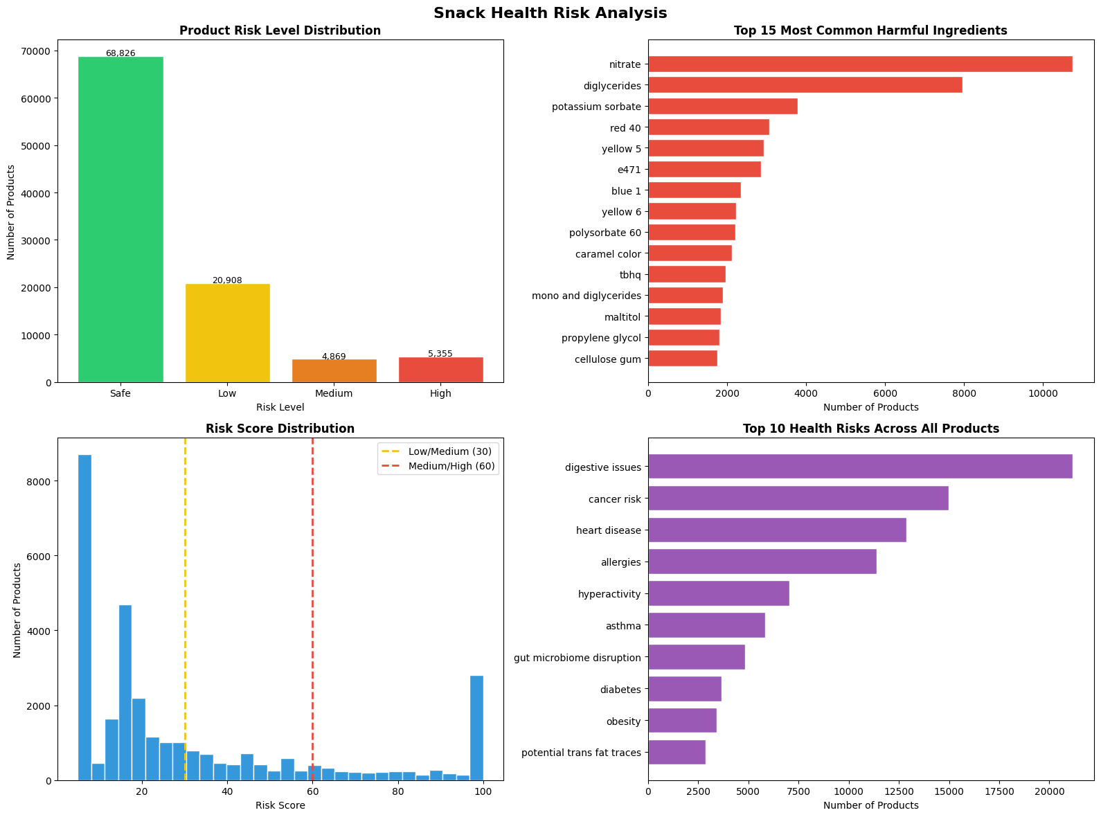
Final Version Results — Actual Charts
health_risk_analysis.png · generated by Final_Version__1_.ipynb · 99,958 products
Top chemical: nitrate (10,600 products) · Top disease: digestive issues (21,171) · 31.1% products contain harmful ingredients

Slide 13
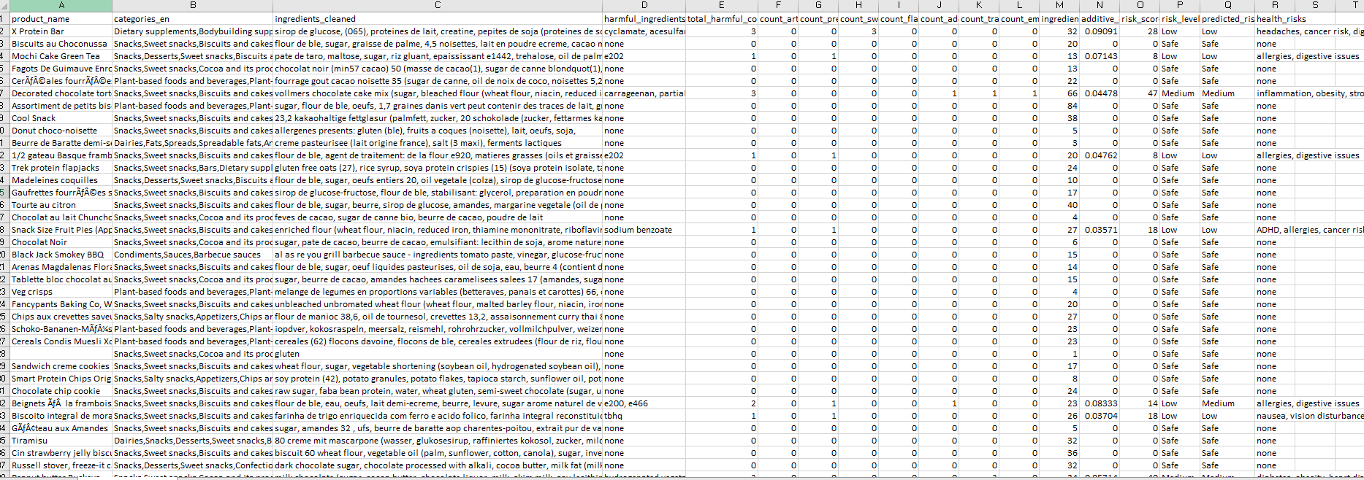
Final Dataset
ap
Build a data-driven system that transforms raw ingredient text into meaningful health risk insights at the product level
Connect large-scale grocery product data with CTD chemical–health datasets — something no existing tool does automatically

Slide 14
Top 10 Highest Risk Products (Score = 100)
1
100
Clásicos
e102, e129, e133, allura red, e320, bha, e321, bht, tbhq
2
100
Prawn Crackers — Spicy
e102, e129, bha, tbhq, aspartame, msg, e627, e631, silicon dioxide
3
100
Hand Pie
sodium benzoate, bha, carrageenan, titanium dioxide, partially hydrogenated
4
100
Grilled BBQ Corn Chips
e104, e110, e122, e124, e133, e150, tbhq, aspartame, msg, e627
5
100
Cookies N Cream Mousse
sodium benzoate, bha, tbhq, titanium dioxide, partially hydrogenated
6
100
Frosted Sugar Cookies
bha, bht, tbhq, titanium dioxide, partially hydrogenated, hydrogenated veg
7
100
Steak Sauce
e142, e202, sodium benzoate, tbhq, sucralose, acesulfame, msg, e627
8
100
Doritos Sweet Chili 45g
e110, e122, tbhq, aspartame, msg, e627, e631, silicon dioxide
9
100
Cakebabies
sodium benzoate, bht, carrageenan, titanium dioxide, partially hydrogenated
10
100
Crispy Marshmallow Squares
sodium benzoate, bht, tbhq, titanium dioxide, partially hydrogenated palm

Slide 15
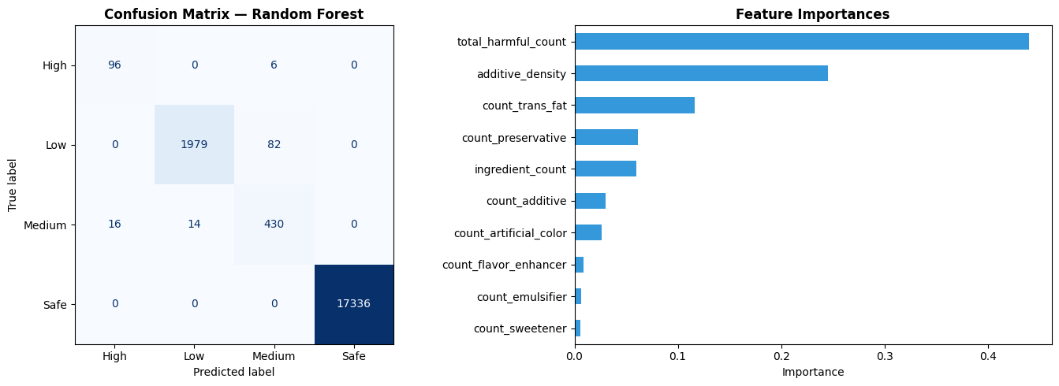
ML Model — Confusion Matrix & Feature Importance (Actual)
model_evaluation.png · Final_Version__1_.ipynb · test set: 19,959 rows · Random Forest + GridSearchCV
High
Low
Medium
Safe
Overall
P:86% R:94% F1:0.90
P:99% R:96% F1:0.98
P:83% R:93% F1:0.88
P:100% R:100% F1:1.00
P:— R:99% F1:0.995

Slide 16
Pipeline 2 — R&D (CTD Auto-Detection, 5K Sample)
R_D.ipynb · 5,000 sampled rows · Translation + CTD matching · InferenceScore as weight
1
📂
2
🔧
3
🌍
4
🔄
Sample 5K
Fix Encoding
Detect Language
Translate → English
random_state=42
reproducible
ftfy: Ã©→é
mojibake fixed
langdetect: 20+ langs
40.6% EN, 30.6% FR
deep-translator
~3k non-EN rows
5
🧬
6
🔍
7
⚖️
8
📊
Build CTD Lookup
CTD Auto-Scan
Risk Score
3 Visualizations
179k chemicals indexed
strip MESH: prefix fix
token → ChemID
InferenceScore=weight
CTD score→weight
200+→25, 100+→20
4-chart + pie charts
+ model eval
9
🤖
10
🎛️
11
📈
5 ML Features
GridSearchCV
97.3% Accuracy
ctd_match_count
max_inference_score+3
best: depth=10
50 trees, split=2
CV: 0.954
ctd_auto_results_5k.csv

Slide 17
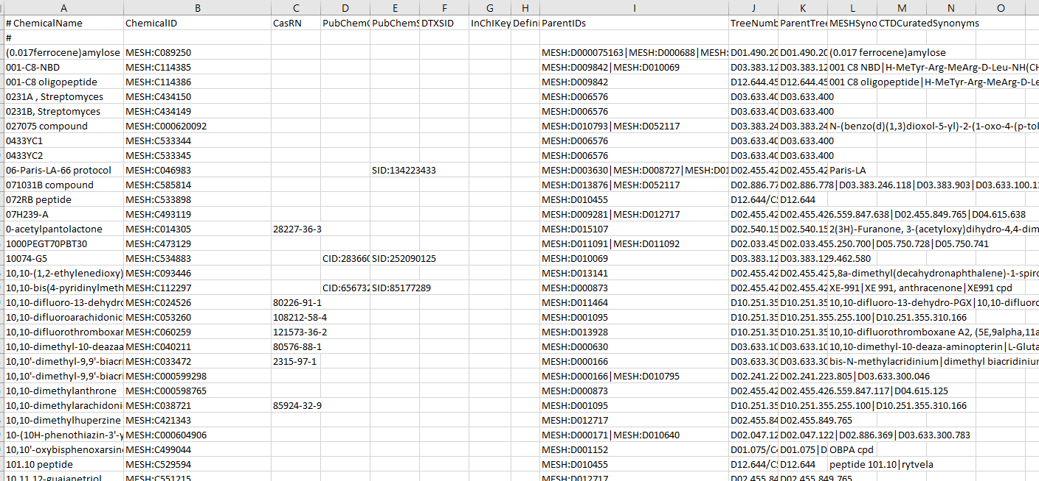
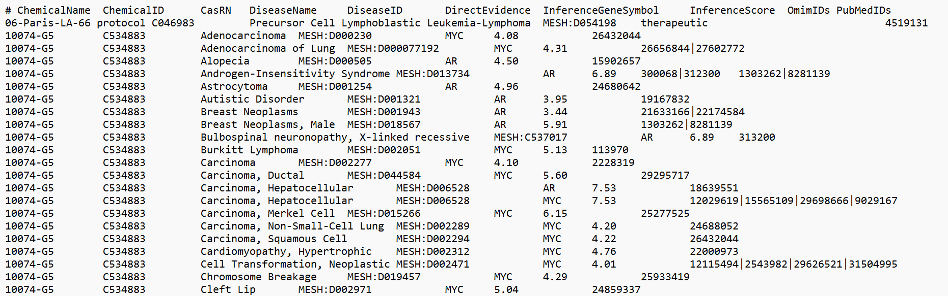
CTD - Dataset
CTD-Disease
CTD-Chemicals
ap
Build a data-driven system that transforms raw ingredient text into meaningful health risk insights at the product level
Connect large-scale grocery product data with CTD chemical–health datasets — something no existing tool does automatically

Slide 18
R&D Phase — What We Tried & Discovered
Experiments Conducted
Language Breakdown (5k sample)
❌
Translate 100k rows
English
40.6%
~10 hrs via deep-translator — too slow
❌
Argostranslate offline
French
30.6%
Broken API — is_installed error
✅
Multilingual embeddings
German
6.9%
paraphrase-multilingual-MiniLM works natively
✅
Translate 5k sample
Spanish
5.5%
15–20 mins — feasible for R&D pipeline
🐛
CTD ID mismatch bug
Italian
3.7%
MESH:C046983 ≠ C046983 — fixed!
✅
E-number matching
Dutch
2.1%
Identical across all languages — instant
Others
10.6%
61% of products are non-English!

Slide 19
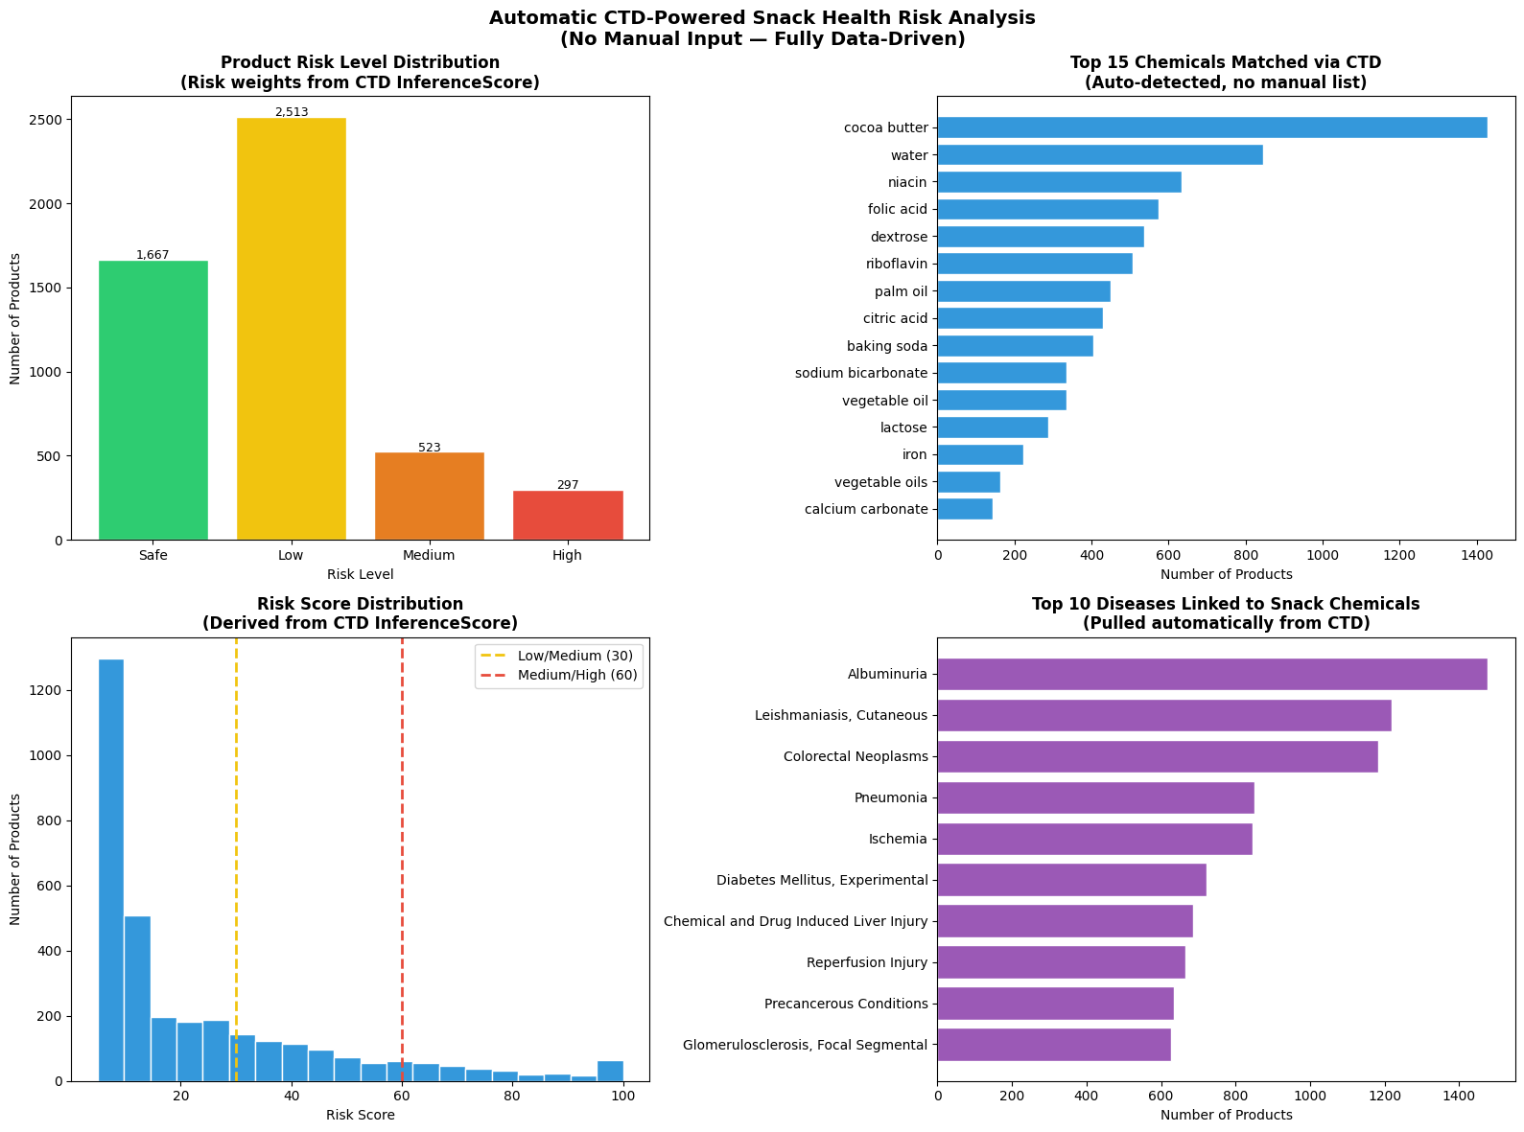
R&D Pipeline — CTD Auto Detection Charts
ctd_auto_analysis.png · R_D.ipynb · 5,000 product sample · CTD InferenceScore as weight
R&D: 5k sample · diseases auto-pulled from CTD · weights from InferenceScore (not manual) · 97.3% RF accuracy

Slide 20
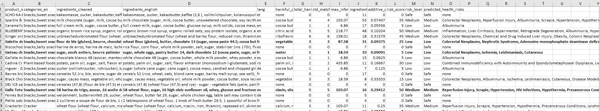
CTD-DataSet
ap
Build a data-driven system that transforms raw ingredient text into meaningful health risk insights at the product level
Connect large-scale grocery product data with CTD chemical–health datasets — something no existing tool does automatically

Slide 21
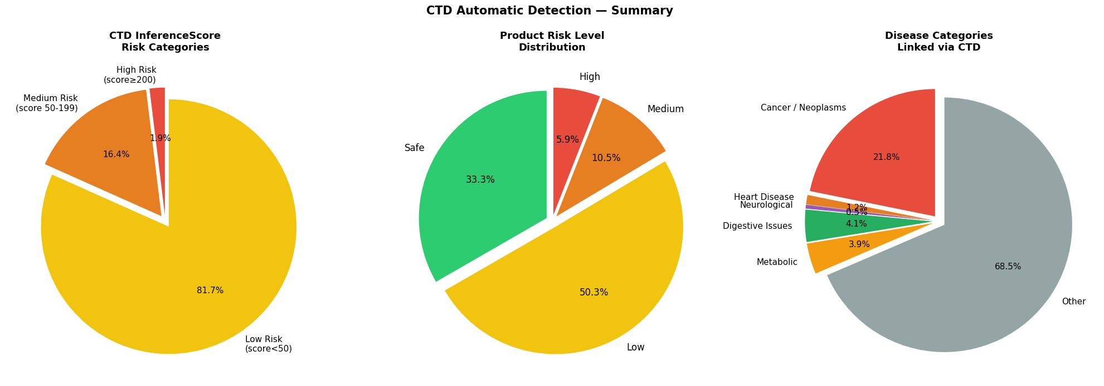
R&D Pipeline — CTD Summary Pie Charts
ctd_pie_charts.png · R_D.ipynb · CTD InferenceScore risk categories + disease breakdown
● 81.7% Low CTD score (<50)
● 50.3% products = Low risk
● 21.8% diseases = Cancer/Neoplasms
Key difference: R&D uses CTD InferenceScore as automatic weight vs Pipeline 1's manually assigned weights

Slide 22
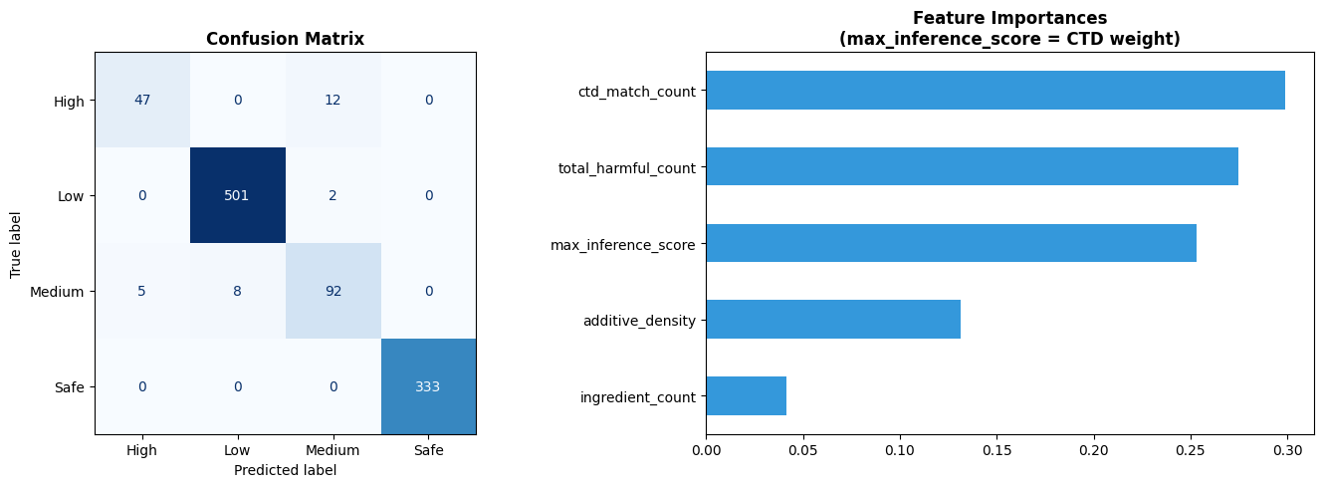
R&D Model Evaluation — Confusion Matrix & Feature Importance
model_evaluation.png · R_D.ipynb · 5k sample · 5 features including ctd_match_count + max_inference_score
Pipeline 1 Features (10):
Pipeline 2 Features (5):
total_harmful_count · additive_density · ingredient_count · count_[7 categories]
total_harmful_count · ctd_match_count · max_inference_score · ingredient_count · additive_density

Slide 23
What These Chemicals Do to the Human Body
🫀
Trans Fats
(Partially Hydrogenated)
☠️
Sodium Nitrite (E250)
🧫
TBHQ (Preservative)
🧠
Aspartame (E951)
W:25
W:20
W:18
W:15
Raise LDL (bad) cholesterol, lower HDL (good). Block arteries → heart attack, stroke. FDA banned 2018 as they cause ~20,000 heart attacks/year.
Converts to nitrosamines in stomach. WHO classifies processed meats (containing nitrites) as Group 1 carcinogen. Strongly linked to colorectal cancer.
Causes nausea, vomiting, vision disturbances at high doses. Animal studies show cancer risk. FDA limits to just 0.02% of fat content.
IARC 2023: possibly carcinogenic. Breaks down to phenylalanine, methanol, aspartic acid in the body. Linked to headaches and neurological issues.
🎨
Artificial Colors
(E102, Red 40, Yellow 6)
🔬
Titanium Dioxide (E171)
🦠
Carrageenan (E407)
🔗
Polysorbate 80 (E433)
W:15
W:15
W:12
W:10
Southampton Study 2007: caused hyperactivity in children. EU requires warning labels. Banned in several countries. Possible cancer risk.
EU banned 2022 after evidence of DNA damage and cancer risk. Nanoparticles can cross gut barrier and accumulate in organs.
Causes inflammation of gut lining. Animal studies show tumor growth. Linked to colitis and IBS. Controversial — banned in some EU products.
Chassaing et al. 2015: disrupts gut microbiome, promotes inflammation. Links to obesity, metabolic syndrome, and IBD in animal models.

Slide 24
Mid-Semester → Final: Key Improvements
 | Mid-Semester | Final Version | Impact
Additives | 6 chemicals | 207 chemicals | 35× more coverage
Data Leakage | ❌ 100% accuracy | ✅ Fixed — independent scoring | Trustworthy model
Risk Label | Binary (0/1) | 4-class Safe/Low/Med/High | Meaningful categories
Response Var | Binary risk_label | 4-class risk_level | Richer classification
Disease Mapping | None | Full health risk links | Clinically relevant
Languages | English only | 10+ via NLP translation | Global coverage
ML Accuracy | 100% (overfit) | 99% (valid & real) | Generalizable
CV Score | 1.0 (suspicious) | 0.983 (realistic) | No data leakage
Key insight: Identifying + fixing data leakage (100% → 99%) shows critical thinking and scientific rigour

Slide 25
Limitations & Future Work
⚠️ Limitations
🚀 Future Work
🔍 Name alias gaps
✅ Expand name aliases
'red 40 lake' not matched vs 'allura red' — same chemical, missed by keyword matching
Add red 40 lake, fdc yellow 6, sulfur dioxide and 20+ more known aliases
🧬 CTD sample is pharmaceutical
🚀 Full CTD database
5k disease rows cover drug compounds, not food additives — limited overlap with food chemicals
Millions of entries would auto-replace manual fallback completely
⏱️ Translation rate limits
📱 Web/mobile app
Google API limits translation to ~5k rows — scaling to 100k needs a better solution
Upload any food label → instant risk score — democratize food safety
📊 High risk underrepresented
🌍 Serving size analysis
Only 102 test samples for High risk → 66% recall. Known limitation of imbalanced datasets
Not just what's in it but how much — dose-response modeling
⚖️ Partially manual weights
🔬 Extend beyond snacks
Pipeline 1 weights are researcher-assigned, not fully automated from data
Cosmetics, medicines, household products using same pipeline

Slide 26
References
1. Dataset https://world.openfoodfacts.org/data
2. CTD Scientific Database (chemical-disease links) https://ctdbase.org/
3. Southampton Study 2007 (artificial colors → hyperactivity) https://www.thelancet.com/journals/lancet/article/PIIS0140-6736(07)61306-3/abstract
4. WHO / IARC — Processed Meat & Sodium Nitrite (Group 1 Carcinogen) https://www.iarc.who.int/wp-content/uploads/2018/07/pr240_E.pdf
5. IARC 2023 — Aspartame (possibly carcinogenic) https://www.iarc.who.int/featured-news/iarc-monographs-evaluate-the-carcinogenicity-of-aspartame/
6. FDA — Trans Fat Ban (partially hydrogenated oils) https://www.fda.gov/food/food-additives-petitions/trans-fat
7. EU — Titanium Dioxide (E171) Ban https://efsa.onlinelibrary.wiley.com/doi/10.2903/j.efsa.2021.6585
8. Chassaing et al. 2015 — Emulsifiers & gut microbiome (Nature) https://www.nature.com/articles/nature14232
9. scikit-learn (Random Forest / ML) https://scikit-learn.org/stable/modules/ensemble.html#forest
10. CTD Database Paper (Nucleic Acids Research 2023) https://academic.oup.com/nar/article/51/D1/D1276/6833202
ap
Build a data-driven system that transforms raw ingredient text into meaningful health risk insights at the product level
Connect large-scale grocery product data with CTD chemical–health datasets — something no existing tool does automatically

Slide 27
Thank You
Questions & Discussion
Sai Lavanya Puthila, Zach Edward · Masters Capstone · Team C
99,958 Products
207 Chemicals
10+ Languages
CTD Database
Random Forest
99% Accuracy
OpenFoodFacts · CTD Database · scikit-learn · Python · NLP · Machine Learning

